Slide 1

AUTOMATIC BRAKING AND SPEED CONTROL SYSTEM USING DEEP NEURAL NETWORKS
MINI PROJECT PROGRESS PRESENTATION- 19ME606
Eastan Saldanha (4NM19ME036)
Chethan (4NM19ME025)
Guide: Mr. Adarsh Rai
Dept of Mech. Engg. NMAMIT Nitte
Dept. of Mechanical Eng. NMAMIT

Slide 2
Flow of the Presentation
Introduction
Literature Review
Objectives
Methodology & Work Done
Conclusion
Dept. of Mechanical Eng. NMAMIT

Slide 3
1. Introduction
Safety is a necessary part of man’s life. According to the report of NCRB of India 3,54,796 cases of road accidents reported during 2020 in which more than 60% of road accidents were caused due to over-speeding
In many road accident cases, a major cause of the accident is the driver distraction and failure to react in time or negligence of the driver or because of failure of braking system to stop the vehicle in time
The number of accidents and the effects of collision can be minimized by reducing the total stopping distance by the developments of automatic braking systems which has led to significant safety in driving
This can be done by systems like Automatic Braking Systems which can be useful as well as helpful
We make use of deep neural network for the efficient and effective speed control and braking
Dept. of Mechanical Eng. NMAMIT

Slide 4
2. Literature Review
Name of the author | Year | Journal/ Paper/others | Details & Summary
Hyunmin Chae, Chang Mook Kang, Byeoung Do Kim, Jaekyum Kim, Chung Choo Chung, Jun Won Choi | 2017 | Autonomous Braking System via Deep Reinforcement Learning | Braking system based on deep reinforcement learning. The proposed autonomous braking system automatically decides whether to apply the brake at each time step when confronting the risk of collision using the information on the obstacle obtained by the sensors. The problem of designing brake control is formulated as searching for the optimal policy in Markov decision process (MDP) model where the state is given by the relative position of the obstacle and the vehicle's speed, and the action space is defined as whether brake is stepped or not.
Rizianiza1 & D.M Shoodiqin2 | 2020 | Automatic braking system using fuzzy logic method | This research is design an autonomous car control system that can reduce the rate of traffic accident. Car prototype is designed by using Fuzzy Logic Control. Fuzzy logic is as main component of artificial intelligence has significantly influence the design controlled system
Dept. of Mechanical Eng. NMAMIT

Slide 5
Name of the author | Year | Journal/ Paper/others | Details & Summary
Jiri David, Pavel Brom, Frantisek Stary, Josef Bradac and Vojtech Dynybyl, Department of Mechanical and Electrical Engineering, SKODA AUTO University | 2021 | Application of Artificial Neural Networks to Streamline the Process of Adaptive Cruise Control | It deals with the use of neural networks for estimation of deceleration model parameters for the adaptive cruise control unit. The article describes the basic functionality of adaptive cruise control and creates a mathematical model of braking, which is one of the basic functions of adaptive cruise control. Furthermore, an analysis of the influences acting in the braking process is performed, the most significant of which are used in the design of deceleration prediction for the adaptive cruise control unit using neural networks.
Automatic Brake Assist during Traffic Light/ Sign Detection | 2021 | Automatic Brake Assist during Traffic Light/ Sign Detection | This paper introduces the real time traffic sign / light detecting system using CNN . With this approach they were be able to recognize different kinds of traffic lights / signs and with their output , they actuate the braking system. This approach is mainly based on 1) implementation of the automatic brake actuating system based on output which will be generated from sensors used for detecting various traffic lights / signs, when the driver can’t apply brakes. 2) Automatic throttle controlling system during detecting the signals like (40 km speed limit, hospital ahead, school ahead etc.)
Dept. of Mechanical Eng. NMAMIT

Slide 6
Name of the author | Year | Journal/ Paper/others | Details & Summary
Salameh A. Sawalha from Faulty of Engineering Technology, Al- Balqa Applied University- Jordan | 2014 | Vehicle Speed Control Equipped with Special Combinations, Brake System and Safe Distance Measurements | It is a system that aims to control vehicle's speed in accordance with the street and road speed limit. The system finds out the whereabouts of the vehicle then it identifies the allowed speed for that particular place. After this, it starts decreasing the speed gradually until it reaches the desirable limit. When the vehicle runs, The GPS finds the location of the vehicle then it sends the longitude and the latitude to the control unit to identify the speed limit of the street. If it has been found that the vehicle's speed exceeds the limit, a signal will be sent to the brake system to reduce the speed until it drops to the limits.
Mariusz Bojarski, Ben Firner, Beat Flepp, Larry Jackel, Urs Muller, Karol Zieba and Davide Del Testa | 2016 | End-to-End Deep Learning for Self-Driving Cars | The article describes the use of convolutional neural networks (CNNs) to map the raw pixels from a front-facing camera to the steering commands for a self-driving car. This powerful end-to-end approach means that with minimum training data from humans, the system learns to steer, with or without lane markings, on both local roads and highways. The system can also operate in areas with unclear visual guidance such as parking lots or unpaved roads
Dept. of Mechanical Eng. NMAMIT

Slide 7
3. Objectives
Objectives
1 | To develop control system for speed control based on Deep Neural Network
2 | To provide safety and stress-free driving atmosphere to the passengers
3 | To save lives and reduce the amount of property damage that occurs during an accident
4 | To provide the intelligence in the braking and speed control system
Dept. of Mechanical Eng. NMAMIT

Slide 8
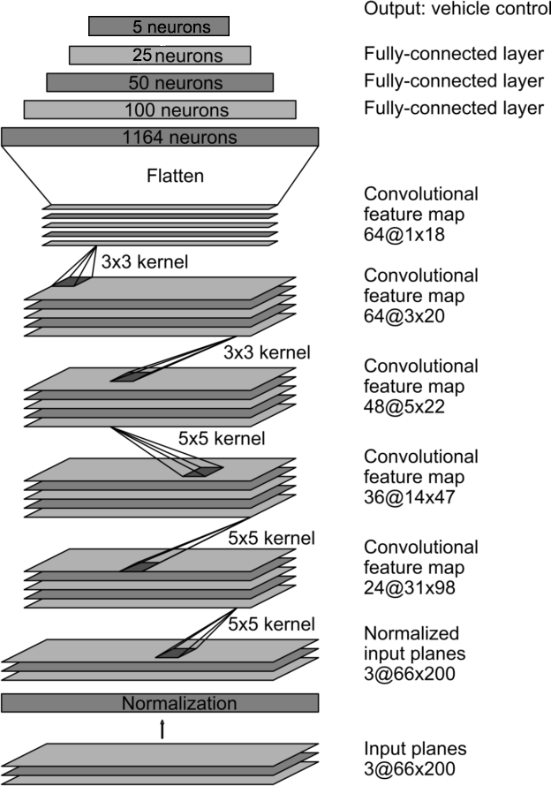
4. Methodology & Work Done
Steps involved in the process,
Collect the environment data using Camera sensor
Pre-processed the collected image
Feed pre-processed image to the AI model
Maintain / reduce / increase the speed as predicted by the model
Key elements,
Model and architecture
Fig. 1.1.1 Model Architecture
Dept. of Mechanical Eng. NMAMIT

Slide 9


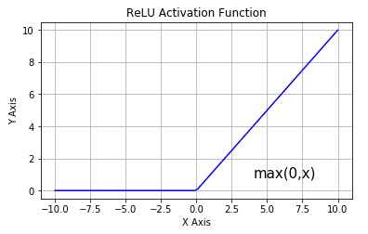

2. Convolution
3. Activation function
4. Optimization Algorithm
$$Fig. 1.1.1 3×3 Kernel$$
Fig. 1.2.2 Convolution
Fig. 1.3.1 ReLU Activation Function
Fig. 1.4.1 Optimization algorithm characteristics
Dept. of Mechanical Eng. NMAMIT

Slide 10
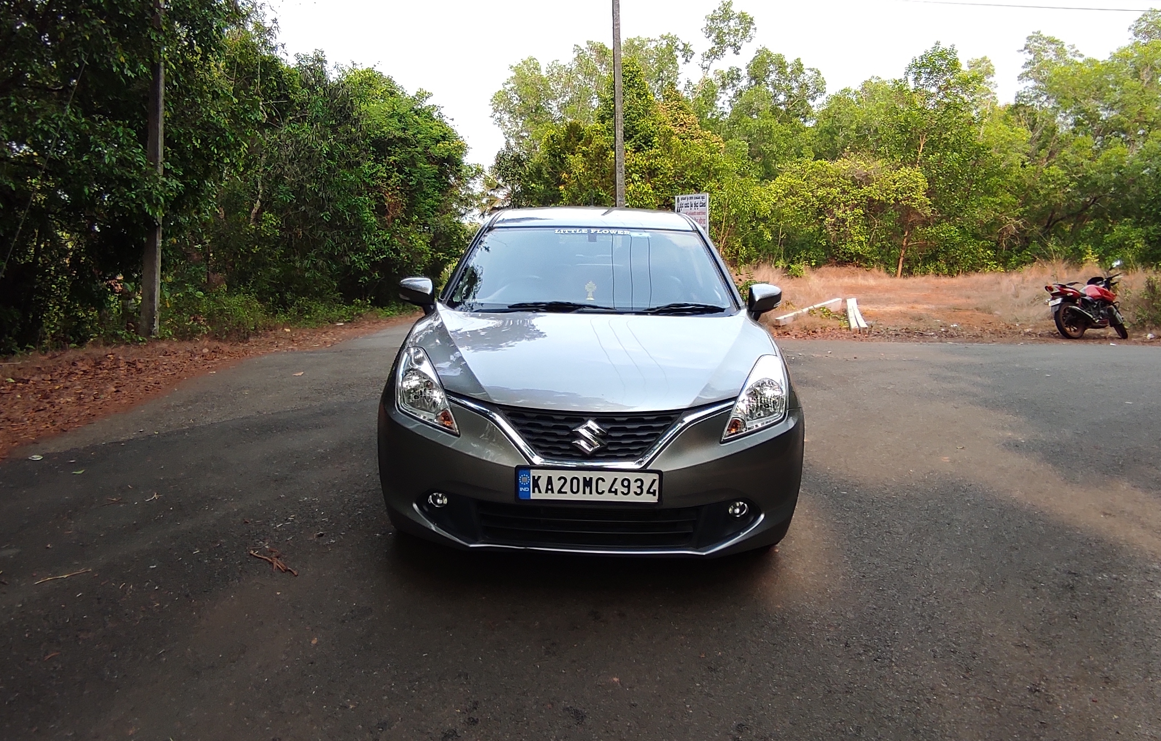
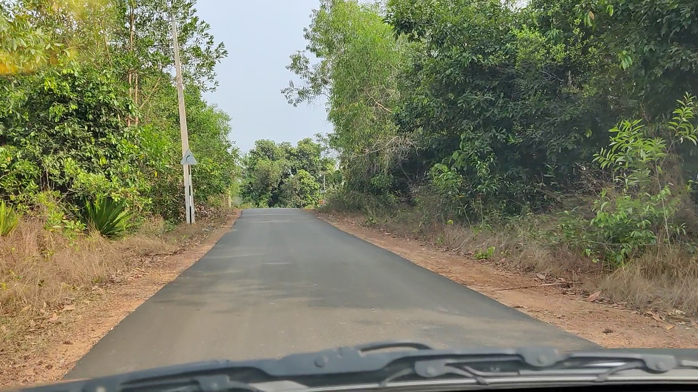
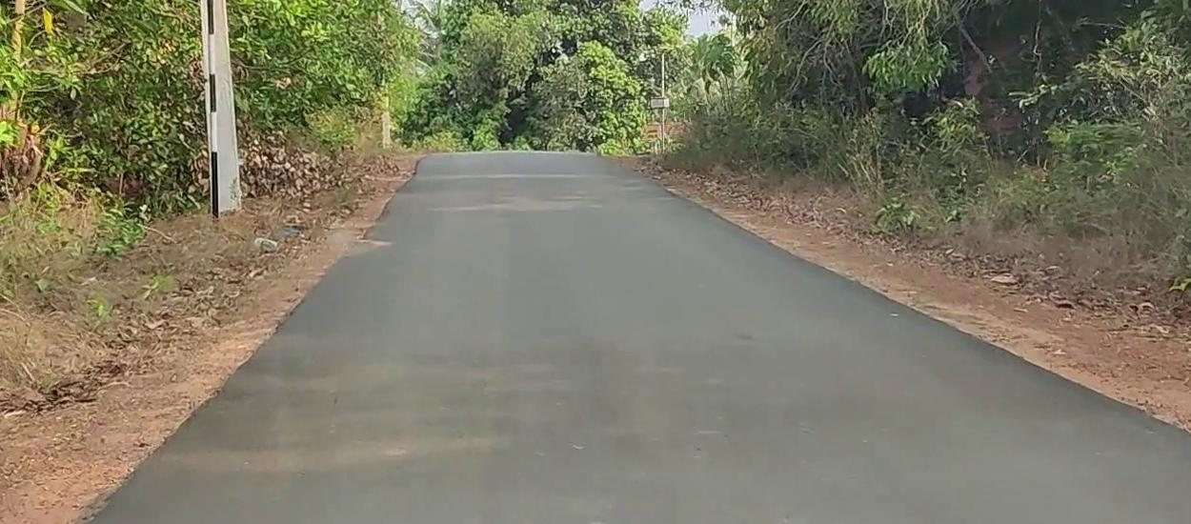
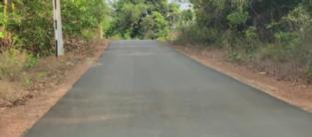
Procedure involved,
1. Data generation
2. Data pre-processing
Noise removal
Data size reduction
Converting text label to numeric label
Fig. 2.1 Picture of Vehicle used for data collection (Maruti Suzuki Baleno)
Fig. 2.2.1 Raw image from the vehicle camera
Idx | Speed Range | Labels(Text) | Labels(Numeric)
1 | 0 <= x <= 5 | stop | 0
2 | 5 < x <= 15 | very low | 1
3 | 15 < x <= 25 | low | 2
4 | 25 < x <= 35 | medium | 3
5 | x > 35 | high | 4
Fig. 2.2.2 Image after removal of noise
/ taking the region of interest
Fig. 2.2.3 Image after performing pyramid scale for lowering of resolution
Table. 1.1 Mapping speed range to label
Dept. of Mechanical Eng. NMAMIT

Slide 11
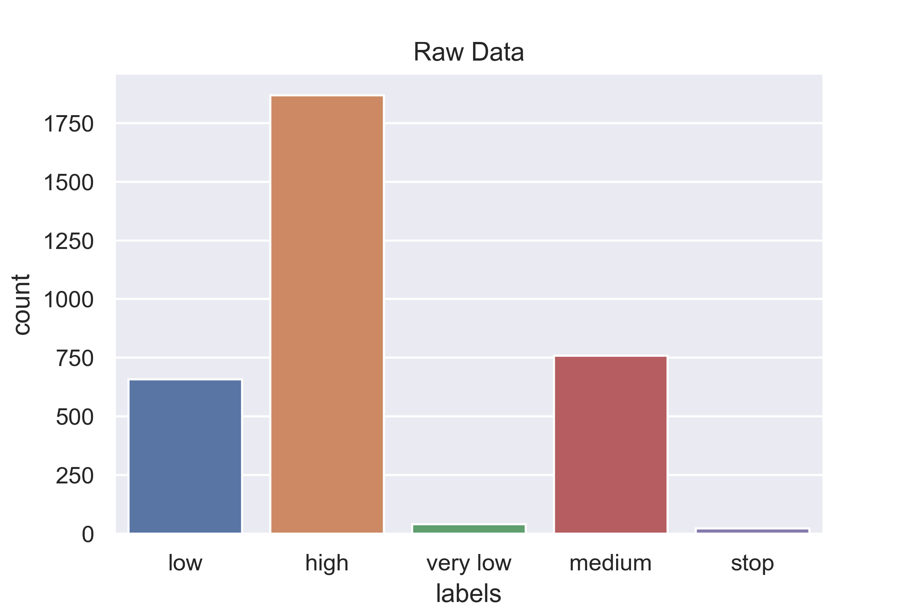
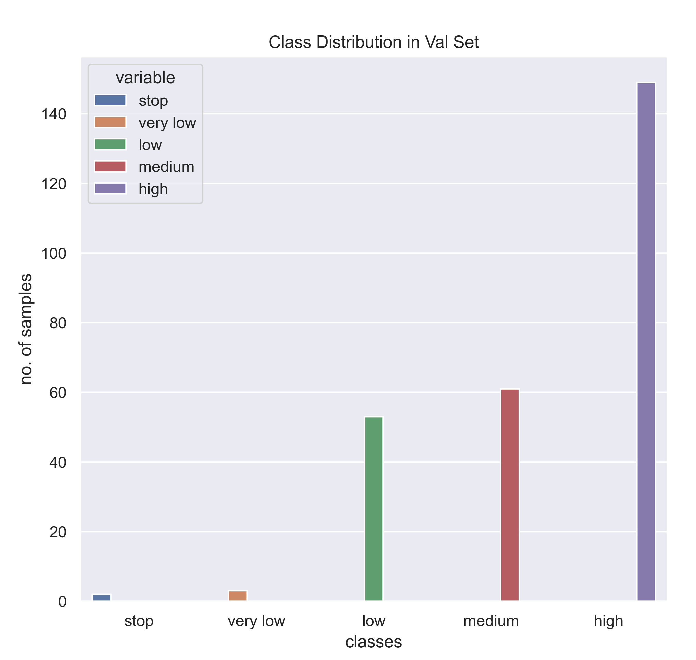
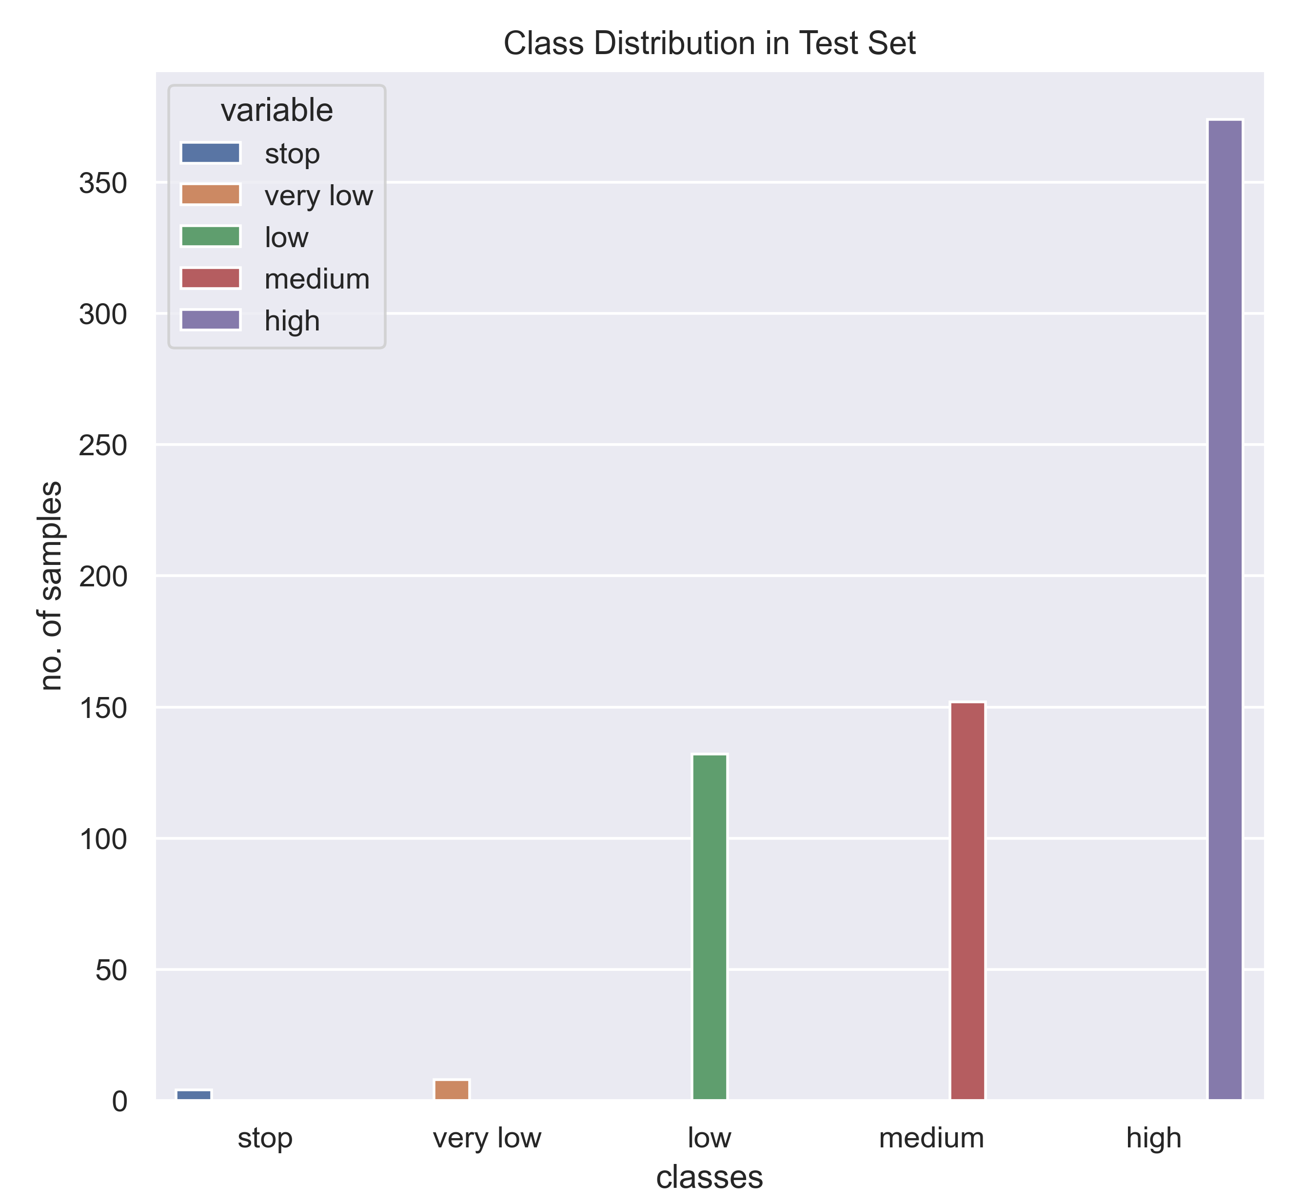
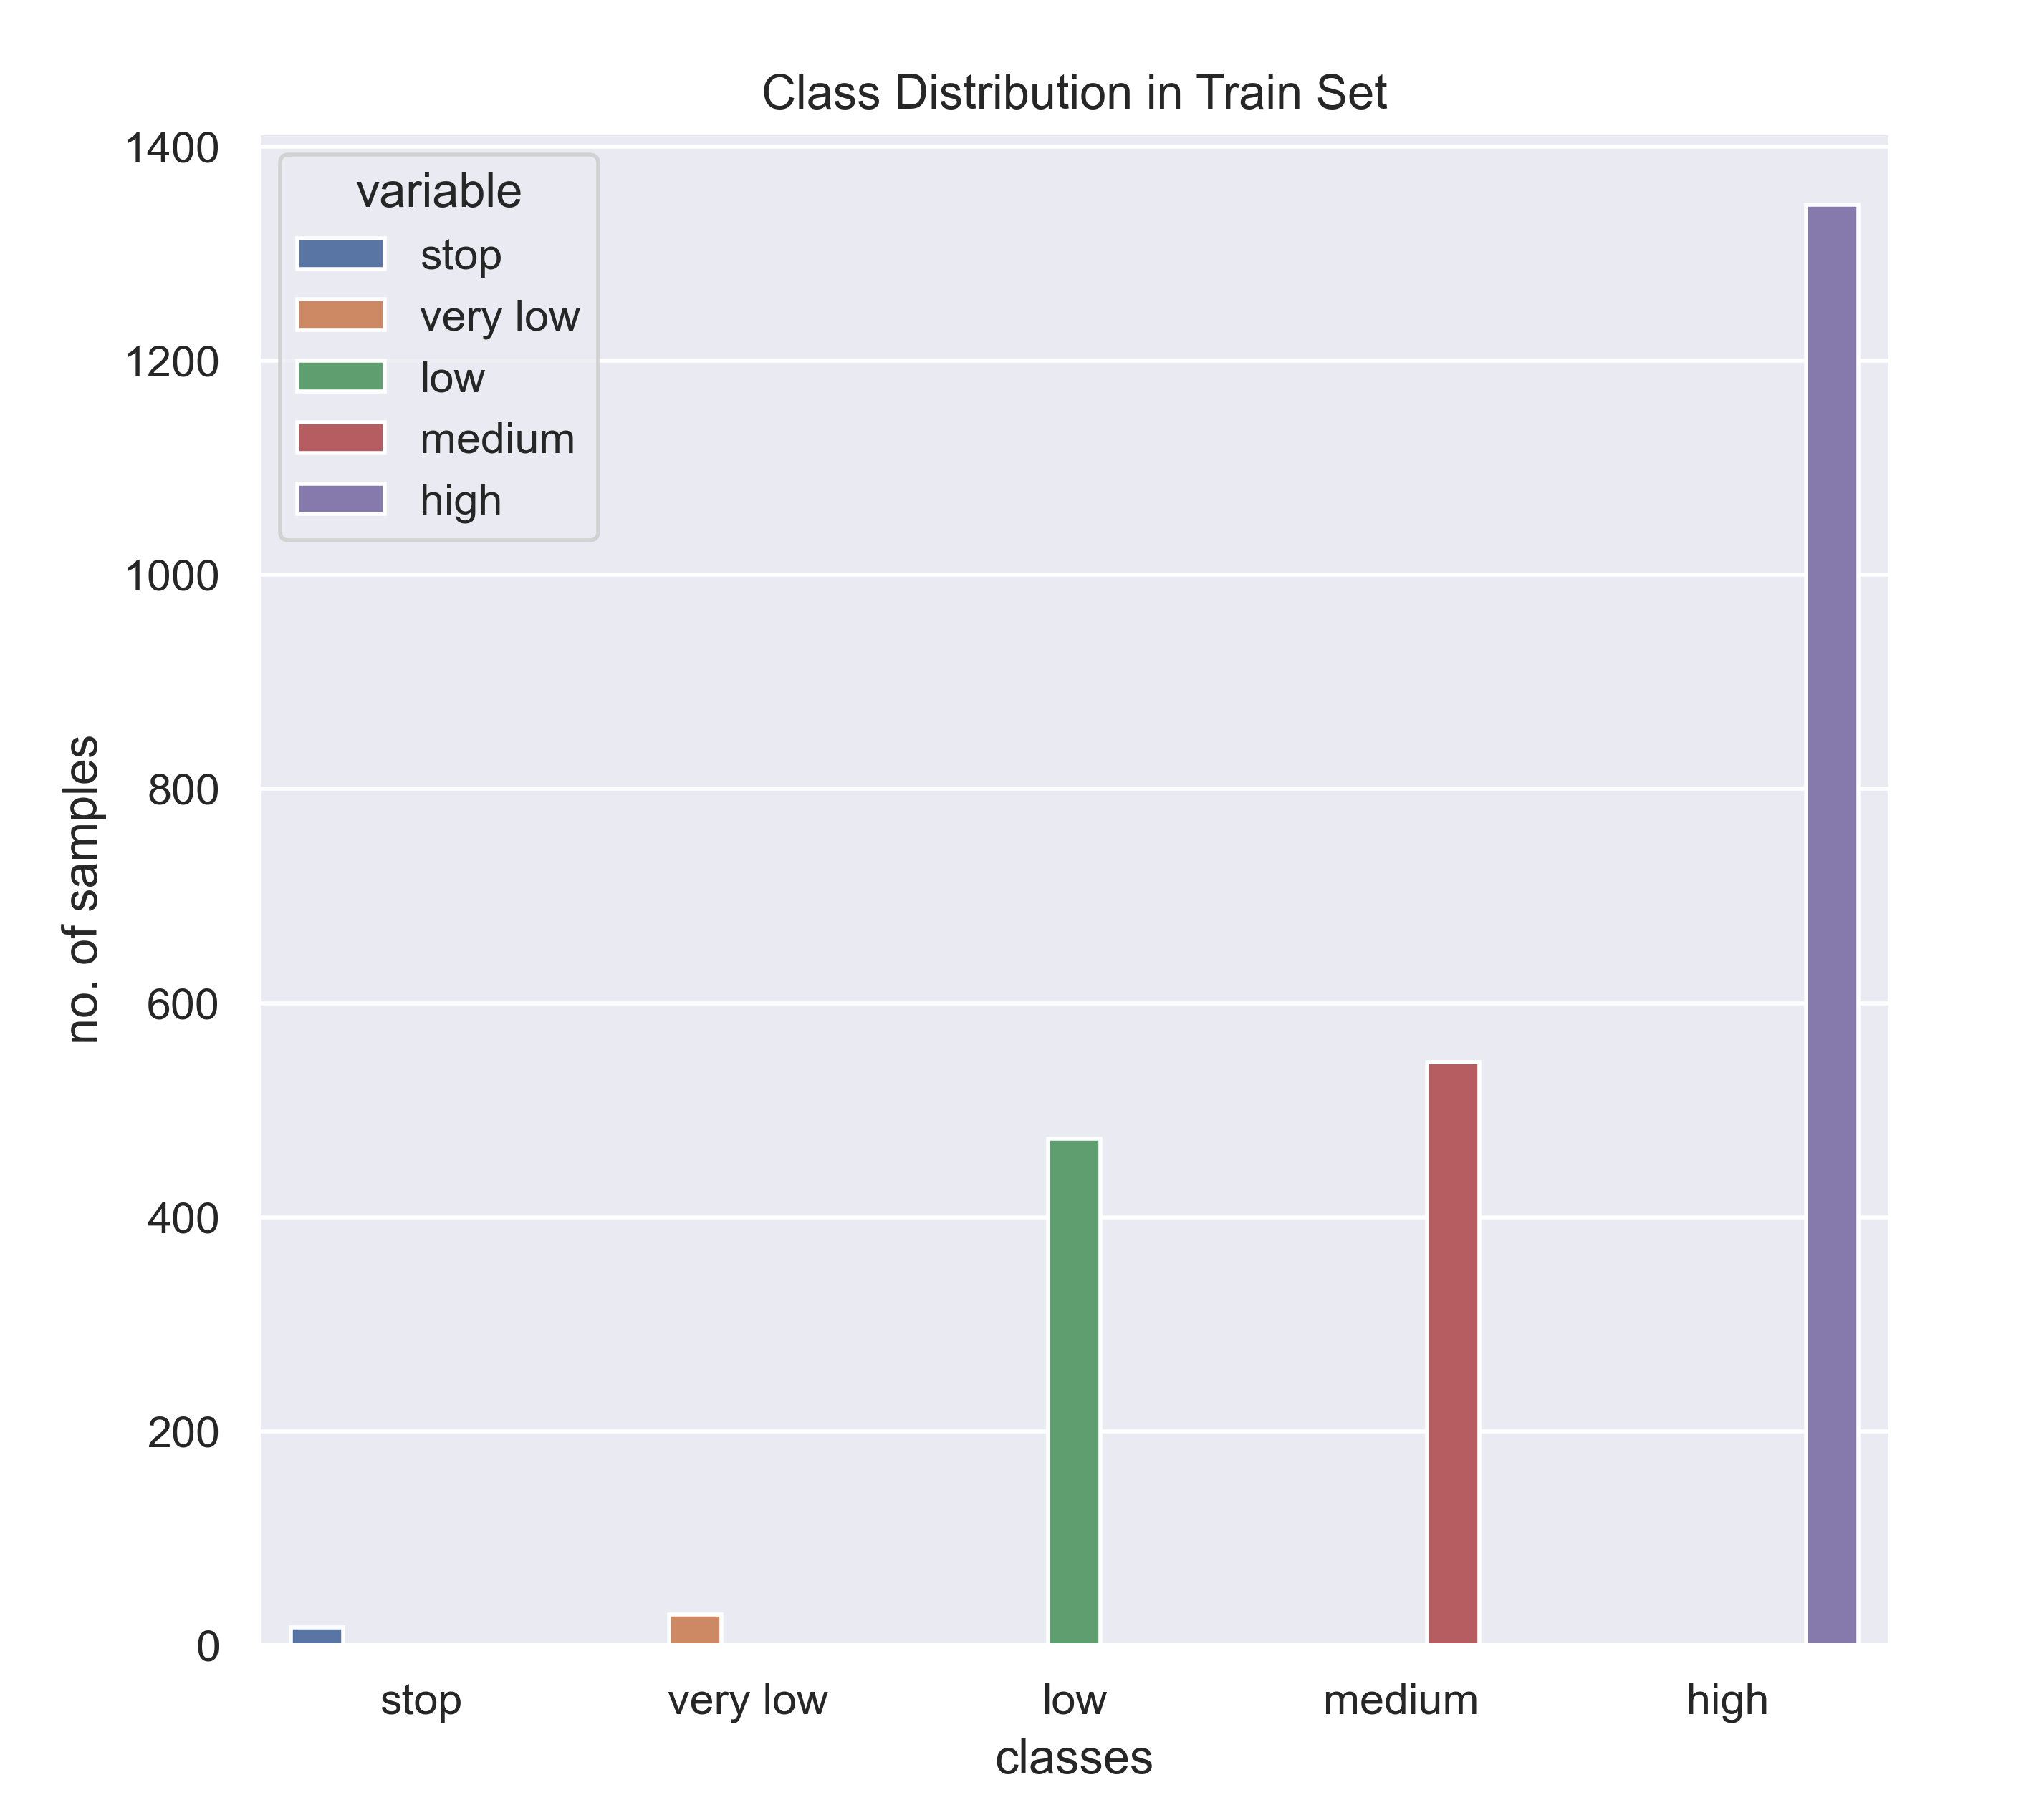
Splitting the data
Training
Validation
Testing
Fig. 3.1 Class distribution in whole data
Fig. 3.2 Class distribution in train data
Fig. 3.3 Class distribution in validation data
Fig. 3.4 Class distribution in test data
Dept. of Mechanical Eng. NMAMIT

Slide 12
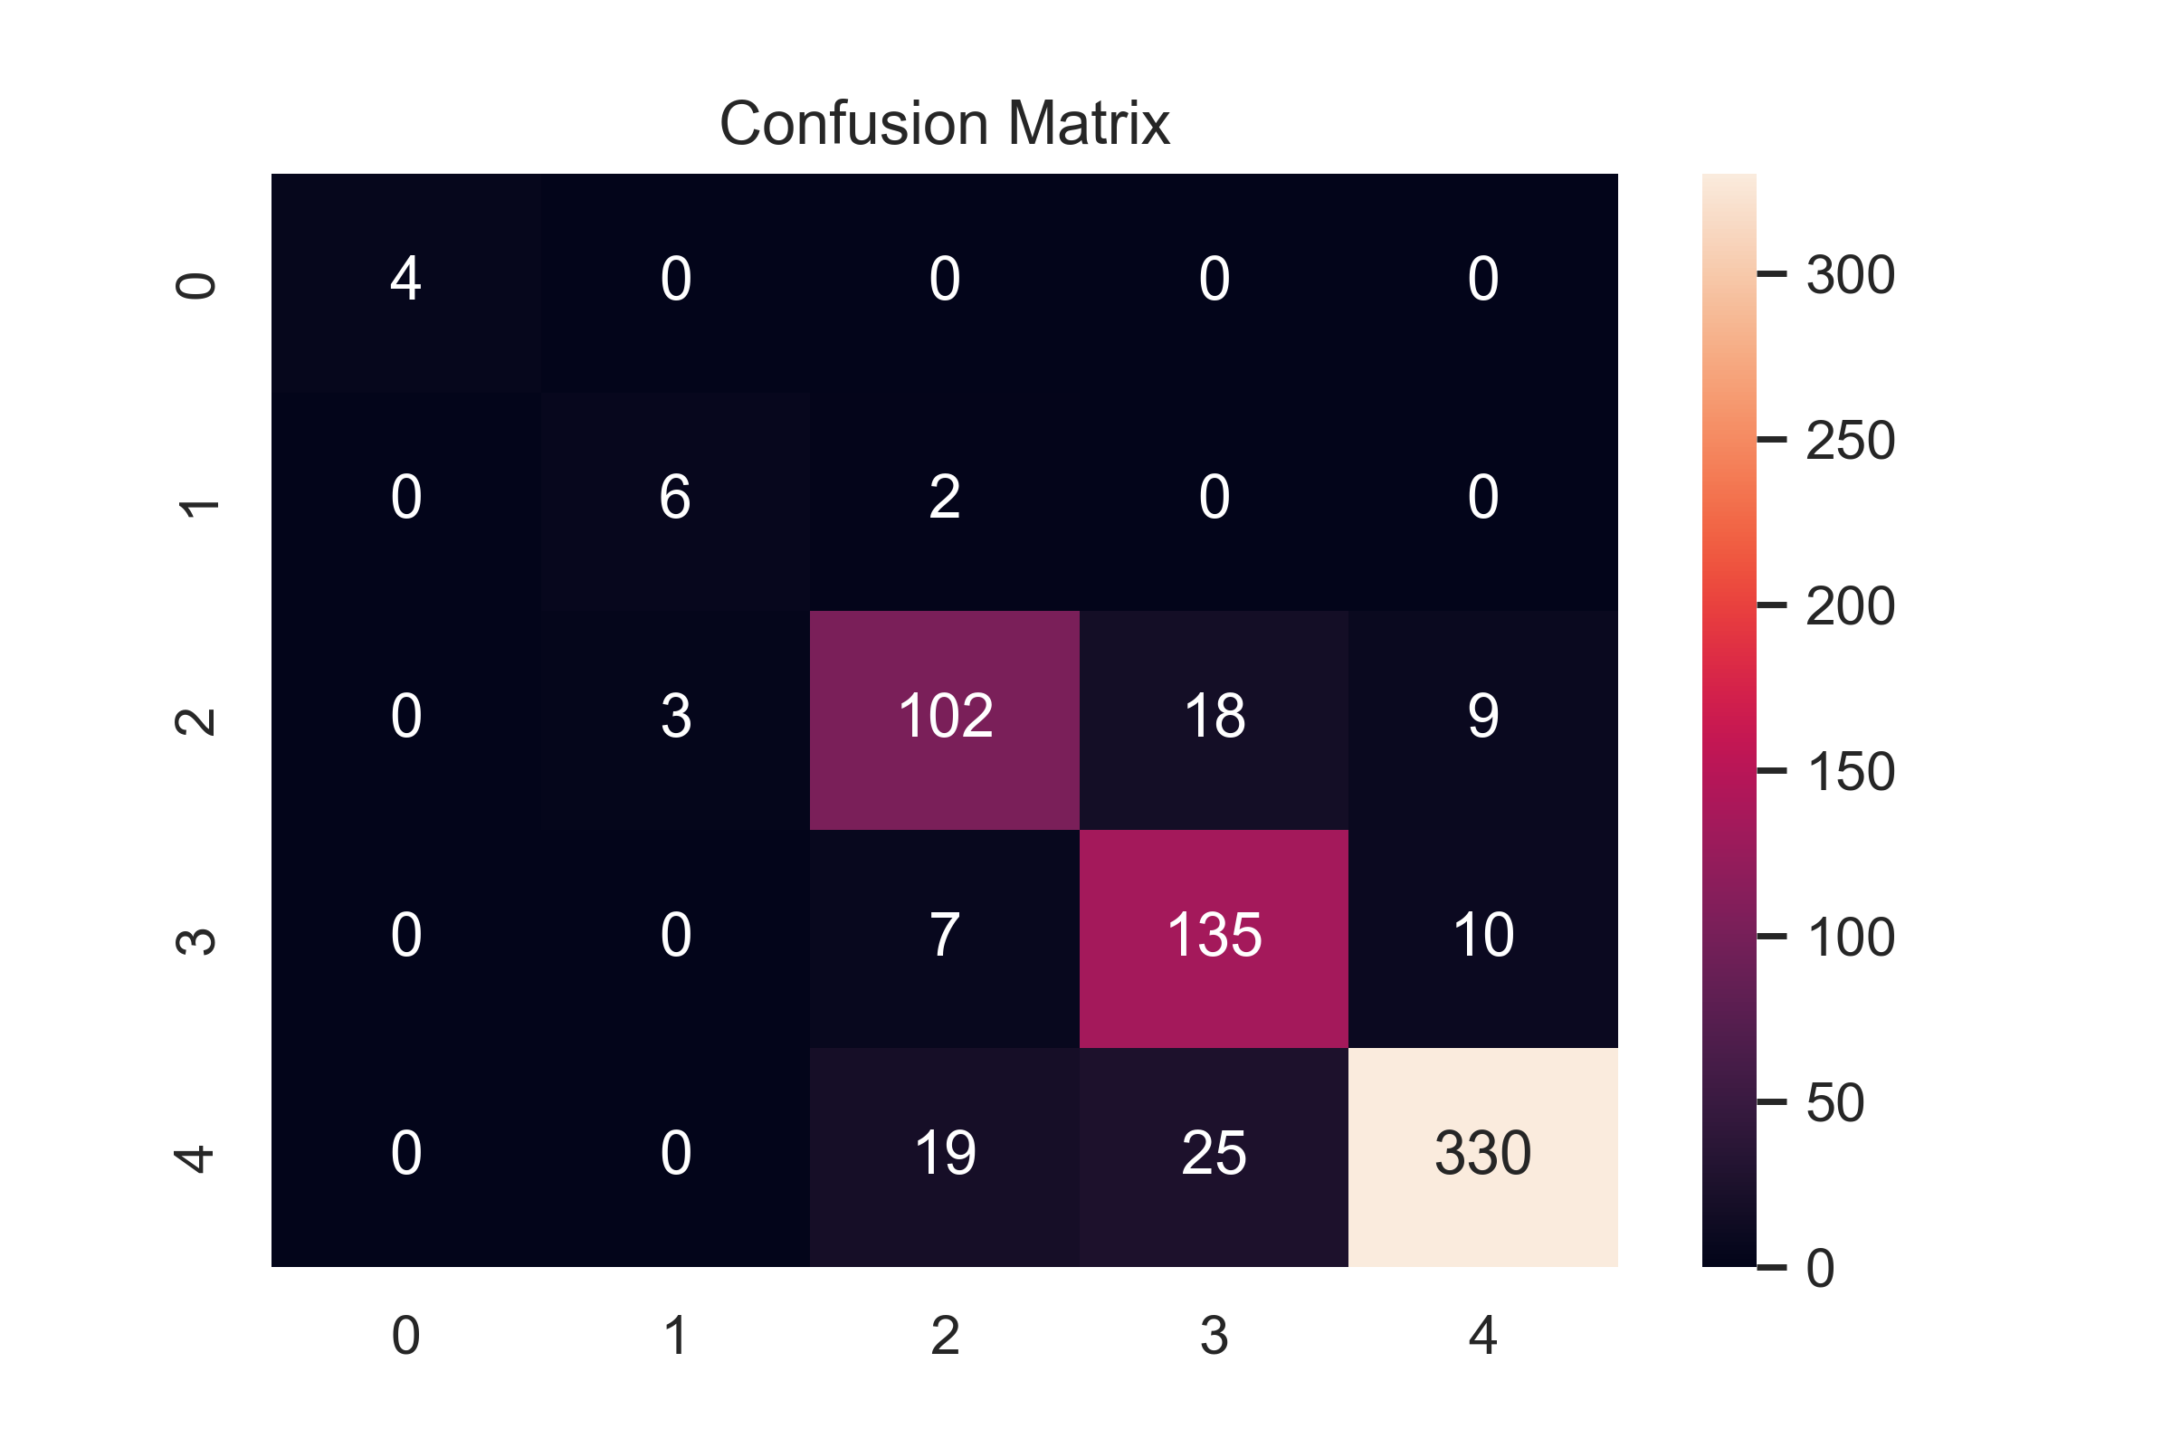
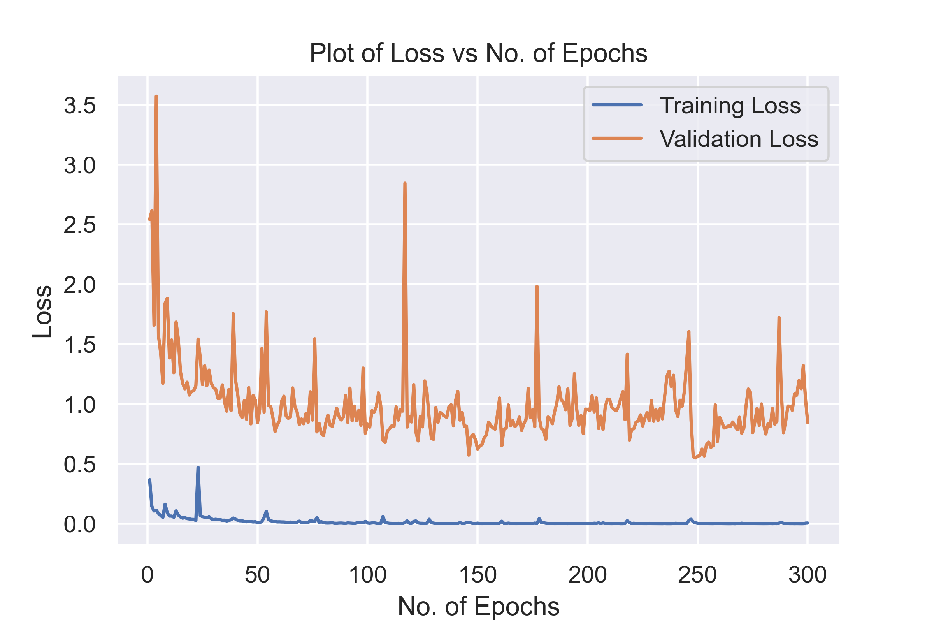
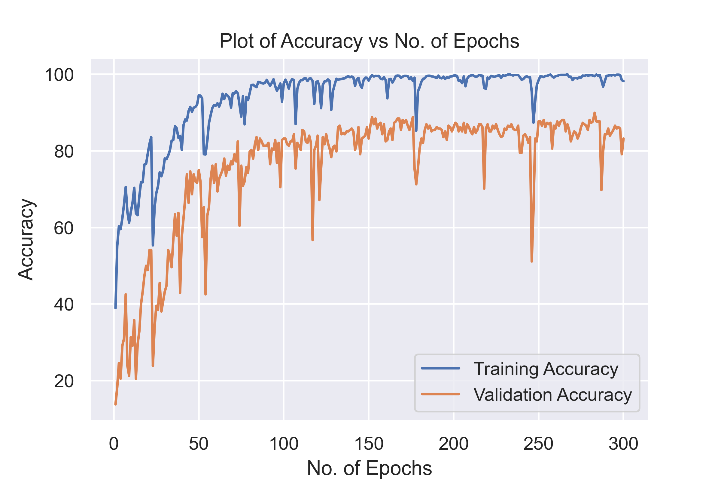
Training the model
Testing the model
Interpreting the results
Fig. 6.0 Confusion matrix of model prediction for test images
Fig. 4.0 Plot of loss vs number of epochs
Fig. 5.0 Plot of accuracy vs number of epochs
Dept. of Mechanical Eng. NMAMIT

Slide 13
Conclusion
The braking system based on the deep learning is intelligent way of brake control which exhibits desirable and consistent brake control behavior for various scenarios where behavior of the pedestrian is uncertain
It can reduce the velocity of the vehicle automatically when a threatening obstacle is detected
The autonomous braking offers safe and comfortable brake control without exhibiting too early or too late braking
The proposed system is more intelligent and prominent over conventional rule-based autonomous braking systems and servers as a principled and goal-oriented system
The main challenge here is that the model has to be trained for lots of kms. with different driving and weather conditions to get best results
Dept. of Mechanical Eng. NMAMIT

Slide 14
Thank You.
Dept. of Mechanical Eng. NMAMIT

